Slide 1
Expertise Around Digital Media
Rudy McDaniel, Ph.D.
Department of Digital Media
University of Central Florida

Slide 2
Purpose & Objectives
Exploratory in nature; framed from the perspective of the humanities
Exploring the tools and techniques that are used when building interdisciplinary expertise around digital media
Concerned with the gray areas that surround the “disciplinary” boundaries of digital media
Before attempting a solution, we must better understand the problem space

Slide 3
A Critical Awareness of Interdisciplinarity
‘Interdisciplinarity’ has something to please everyone. Its base, discipline, is hoary and antiseptic; its prefix, inter, is hairy and friendly. Unlike fields, with their mud, cows, and corn, the Latinate discipline comes encased in stainless steel: it suggests something rigorous, aggressive, hazardous to master; Inter hints that knowledge is a warm, mutually developing, consultative thing.
Roberta Frank qtd. in Moran (2002, p. 3).

Slide 4
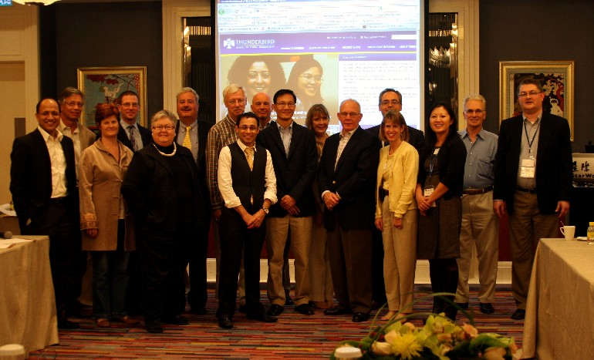
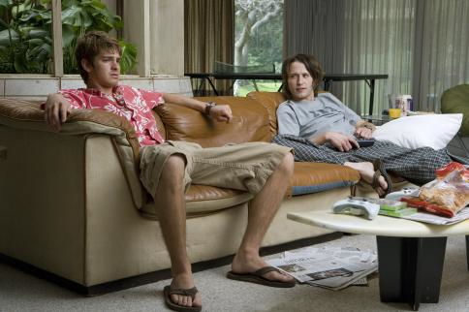

Slide 6
Three Parts
What is expertise in an interdisciplinary context?
What issues and problems are associated with building expertise in an interdisciplinary context? In other words, why is this so tricky?
How do we share expertise around digital media?

Slide 7
WHAT IS IT?
Part I

Slide 8
Data vs. Information vs. Knowledge
Data = observations about the world.
Ex: Facebook has over 400 million active users
Information = data endowed with relevance and purpose (Peter Drucker).
Ex: There are 10,000 Facebook users in my network that I can advertise to.
Knowledge = information with the most value.
Ex: Facebook click-throughs to purchases happen approximately 2% of the time in online ads.

Slide 9
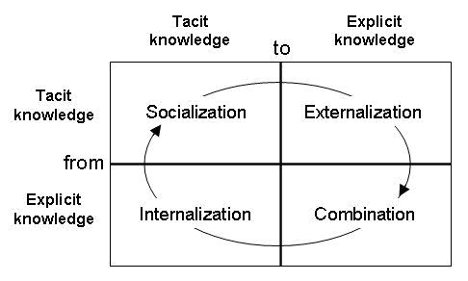
Tacit vs. Explicit Knowledge

Slide 10
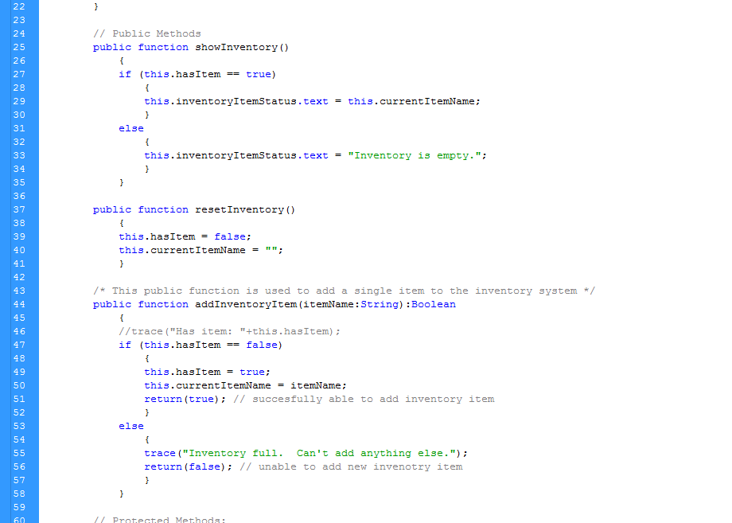

Slide 13
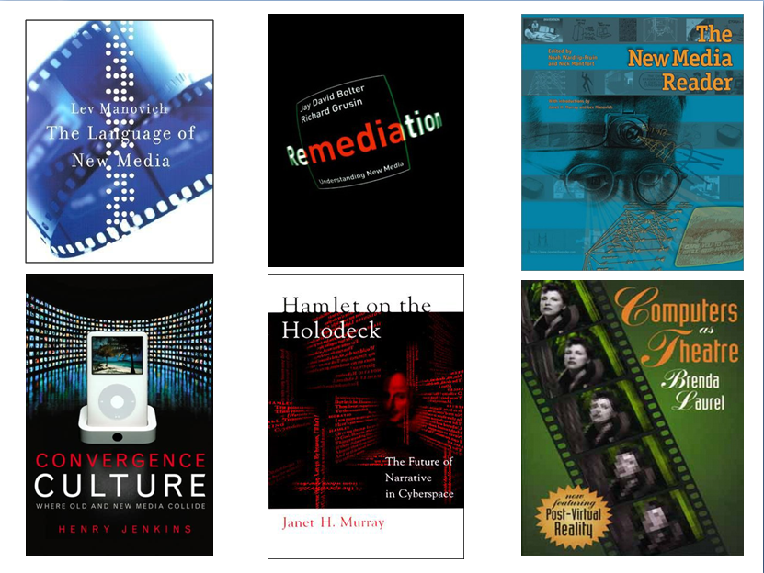

Slide 15
Interdisciplinary Expertise
As apposed to multidisciplinary practices, which “speak as separate voices in an encyclopedic alignment,” interdisciplinary practices integrate “disciplinary data, methods, tools, concepts, and theories in order to create a holistic view or common understanding of a complex issue, question, or problem” (Klein, 2005, p. 55).

Slide 16
Why IS IT SO TRICKy?
Part II

Slide 17
Why Expertise is Tricky in Digital Media
The problem of interdisciplinarity (disciplinary issue)
Faculty come from different backgrounds.
Students have different interests.
The problem of complexity (systems issue)
Technology changes, multiple domains of study, etc.
The problem of expectations (psychological issue)
Entertainment media sets the bar high.
The problem of public policy (political issue)
Everyone’s already an expert in digital media.

Slide 18
Digital Media
Anthropology
Computer Science
Theatre
English
Education
Art
Business
Film

Slide 19
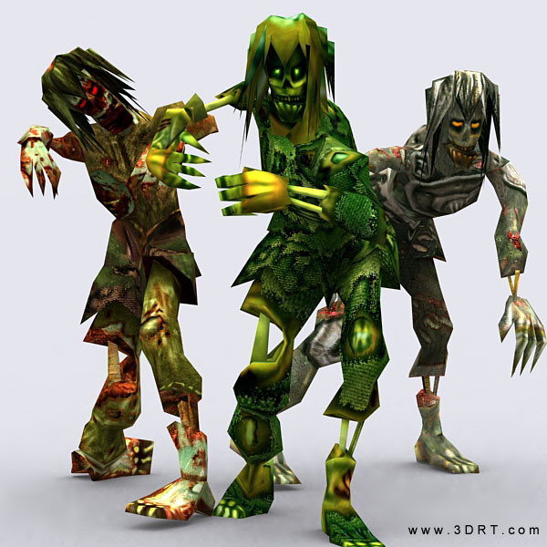

Slide 20
The Zombie Problem
“Consciously doing all we can to free ourselves from the last boundaries of space and time, we are ultimately trading our cultural and societal anchors for an age of glorious freedom, technological innovation—and darkness. As our attentional skills are squandered, we are plunging into a culture of mistrust, skimming, and a dehumanizing merger between man and machine. As we cultivate lives of distraction, we are losing our capacity to create and preserve wisdom and slipping toward a time of ignorance that is paradoxically born amid an abundance of information and connectivity. Our tools transport us, our inventions are impressive, but our sense of perspective and shared vision shrivel” (Jackson, 2008, pp. 15-16).

Slide 21
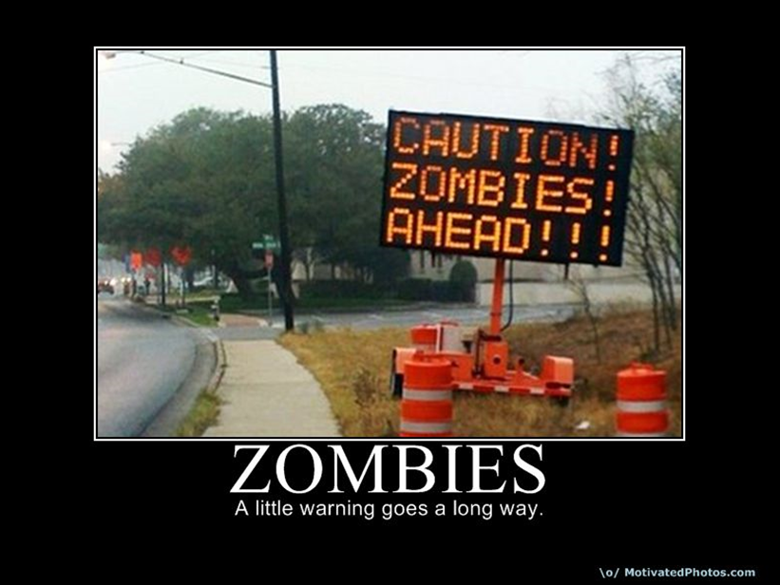
Notes:
We are connected more than ever, but also detached more than ever.
Maggie Jackson, in Distracted: The Erosion of Attention and the Coming Dark Age, writes the following: “Consciously doing all we can to free ourselves from the last boundaries of space and time, we are ultimately trading our cultural and societal anchors for an age of glorious freedom, technological innovation—and darkness. As our attentional skills are squandered, we are plunging into a culture of mistrust, skimming, and a dehumanizing merger between man and machine. As we cultivate lives of distraction, we are losing our capacity to create and preserve wisdom and slipping toward a time of ignorance that is paradoxically born amid an abundance of information and connectivity. Our tools transport us, our inventions are impressive, but our sense of perspective and shared vision shrivel” (pp. 15-16).

Slide 22
Notes:
Ninjas:
We borrow from other disciplines and they are often unaware and having a perfectly good time without us.

Slide 23
The Ninja Problem(s)
Sven Birkerts (1994) The Gutenberg Elegies
Problems with the “electronic era”:
Language erosion (silence)
Neil Postman: complex discourse patterns flattened by their need to be communicable over distance
Flattening of historical perspectives (hidden)
“The more we grow rooted in the consciousness of the now, the more it will seem utterly extraordinary that things were ever any different”
The waning of the private self (death of the individual)

Slide 25
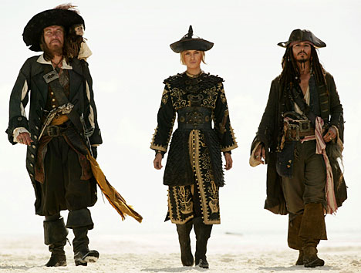

Slide 26
The Piracy Problem
Julie Thompson Klein (1990) notes that “borrowing” is quite common in academia; one discipline routinely borrows from another that is more established or well-known.
There are, however, problems with borrowing. Here are just three of them (p. 88):
Distortion and misunderstanding of borrowed material
Use of data, methods, theories, and concepts out of context
Use of borrowings out of favor in their original context

Slide 27
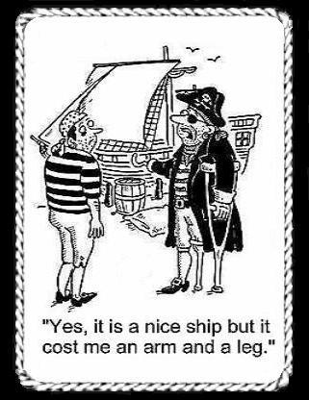
Notes:
Pirates:
Expertise in digital media comes from successfully navigating the areas around digital media.
We do this to move products, transport ideas, and make cultural waves.

Slide 28
HOW DO WE SHARE IT?
Part III

Slide 29
Information Ecology
What we’re dealing with, then, is a complex system of knowledge and relationships.
Davenport & Prusak (1997) use the metaphor of ecology to study and understand informational systems in business. Ecology is the science of understanding and managing whole environments.
Four key attributes of information ecology:
Integration of diverse types of information
Recognition of evolutionary change
Emphasis on observation and discussion
Focus on people and information behavior

Slide 30
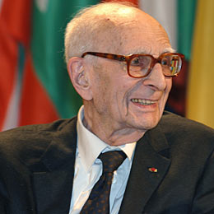
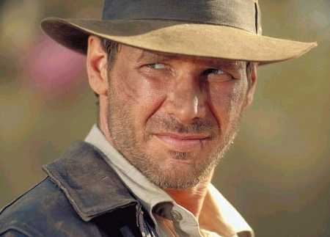
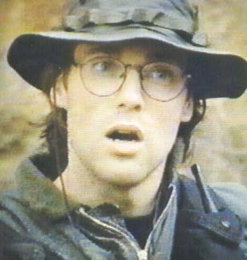
Notes:
Jane Goodall
Claude Levi-Strauss

Slide 31
Pirates, Ninjas, and Zombies
How do we define expertise in an interdisciplinary context?
How do we share expertise with our students and the general public?
How do we educate with expertise as an ultimate goal for learners?
Notes:
Define: successfully navigating the open waters of digital media to inform, persuade, or communication to an audience.
Share: Package complex information into stealthy forms that piggyback on other ideas or disciplines. Use bridging techniques like storytelling, metaphor, and figurative language in order to drive concepts home.
Educate: Engage students by breaking zombie-like trances and hammering home facts and principles that eventually evolve into foundational knowledge and later expertise.

Slide 32
Thank You!
Birkerts, S. (1994). The Gutenberg Elegies: The fate of reading in an electronic age. Boston: Faber & Faber.
Davenport, T., & Prusak, L. (1997). Information ecology: Mastering the information and knowledge environment. London: Oxford UP.
Jackson, M. (2008). Distracted: The erosion of attention and the coming dark age. New York: Prometheus Books.
Klein, J.T. (1990). Interdisciplinarity: History, theory, & practice. Detroit: Wayne State UP.
Moran (2002). Interdisciplinarity. Routledge: London.
My email: rudy@mail.ucf.edu
My web site: www.dm.ucf.edu/~rmcdaniel

